Slide 1

Breast Cancer Statistics
Asha Cumberbatch

Slide 2
Introduction
Purpose
To investigate the effect of mammography use on breast cancer mortality rates in the US.
Beneficiaries
Hospital and healthcare systems
Cancer societies
Government agencies running awareness campaigns

Slide 3
Methodology
The dataset was published by the CDC and downloaded from data.gov as a CSV.
Analysis focused on breast cancer statistics available at the state level, and among Black, White and Hispanic women in the Tristate area.
The pandas, matplotlib and seaborn packages were imported to Jupyter notebooks to aid data exploration, cleaning and visualization.

Slide 4
Research Questions
1. Do some states have a higher mammography rate than others?
2. Do some states have a higher breast cancer mortality rate than others?
3. Are mammography rates significantly different among White, Black and Hispanic women in the Tri-state area?
4. Are breast cancer mortality rates significantly different among white, black and Hispanic women in the Tri-state area?

Slide 5
Results

Slide 6
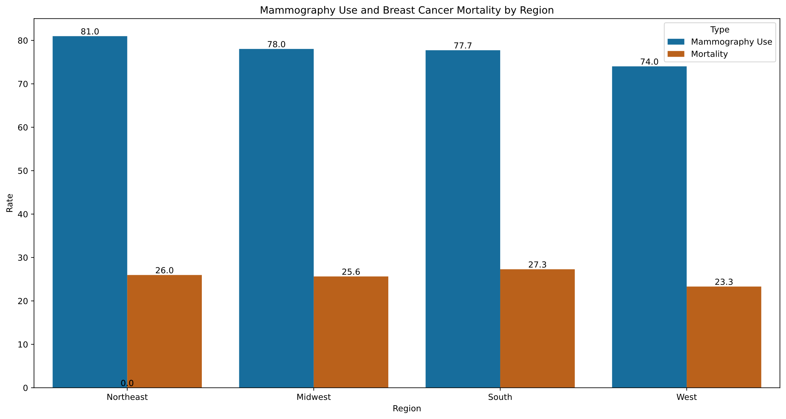
Mammography use and breast cancer mortality rates are similar across the country

Slide 7
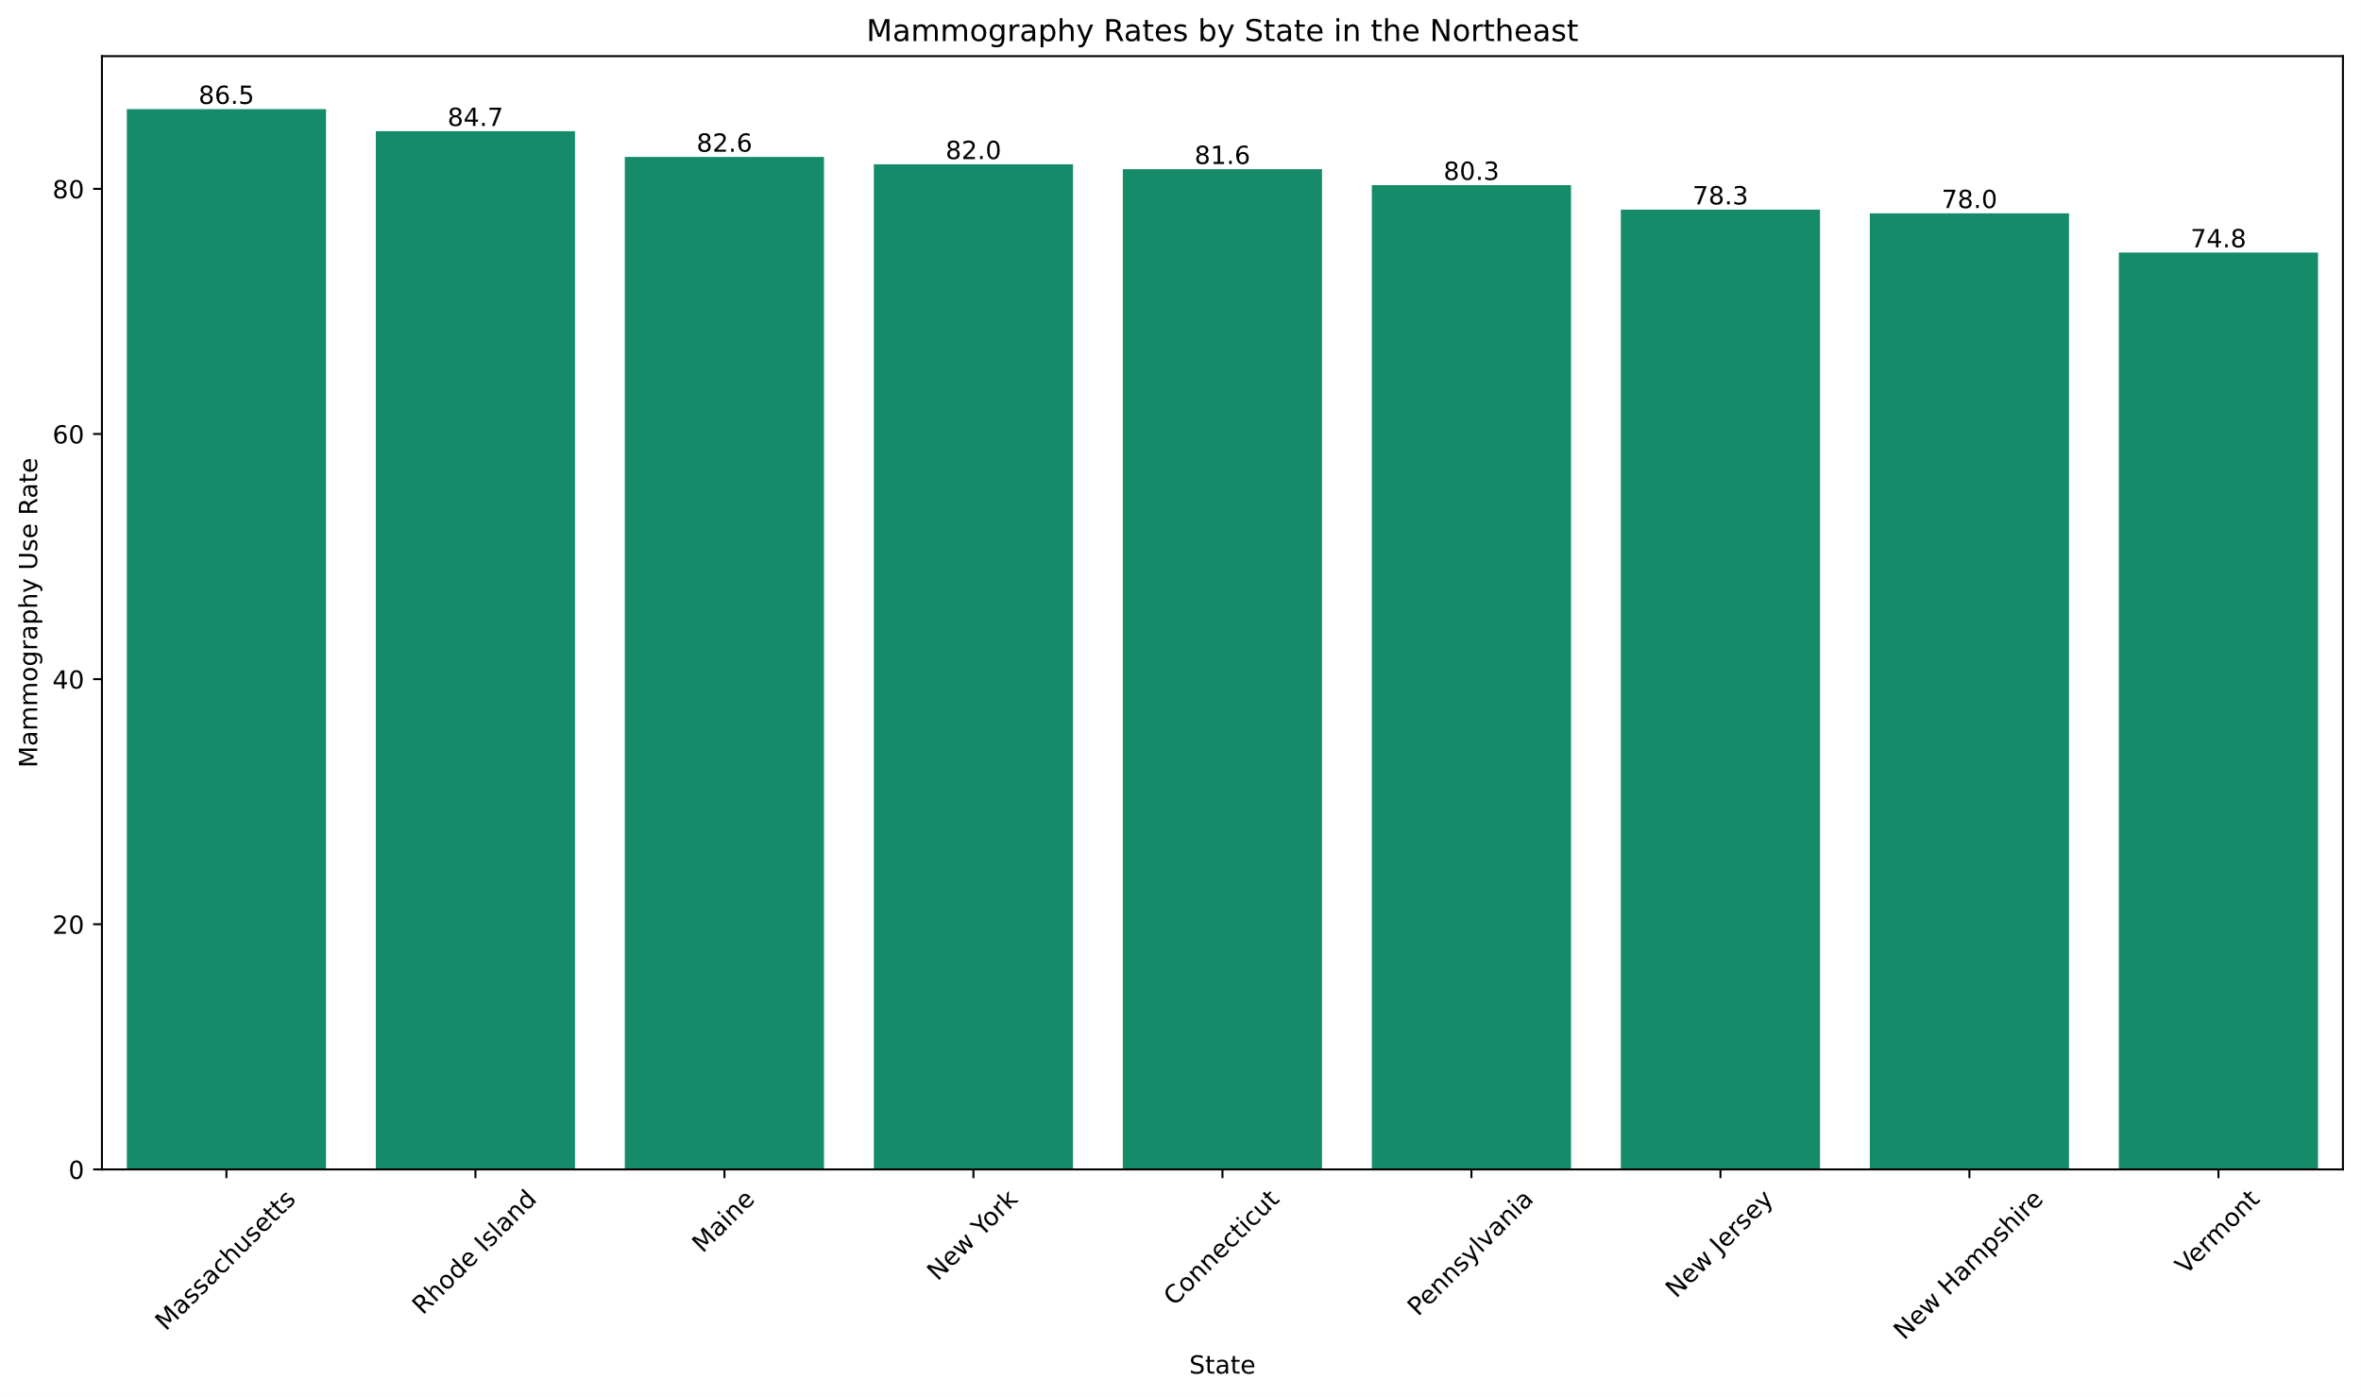
Massachusetts in the Northeast has the highest mammography usage rates in the country

Slide 8
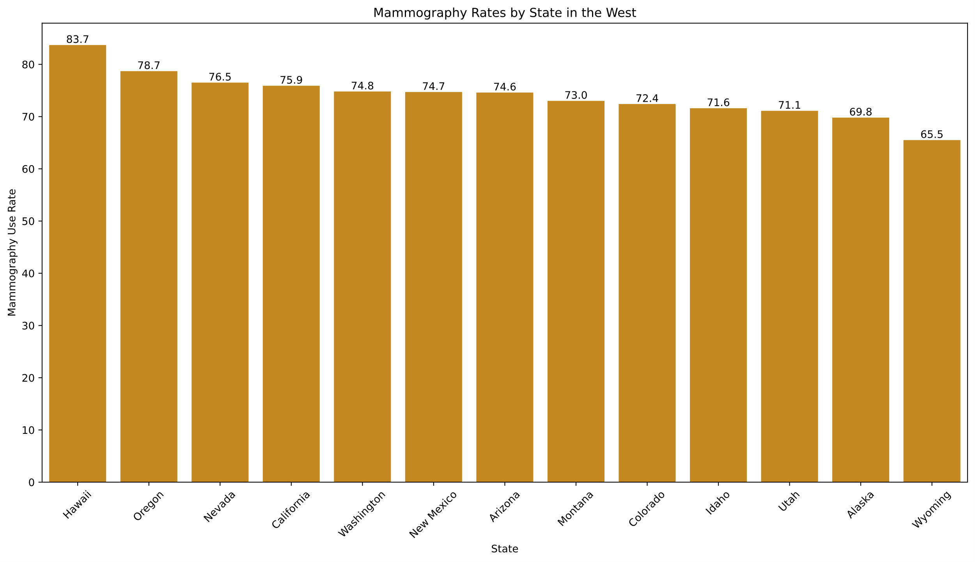
The West has the state with the lowest mammography usage, and the most variation

Slide 9
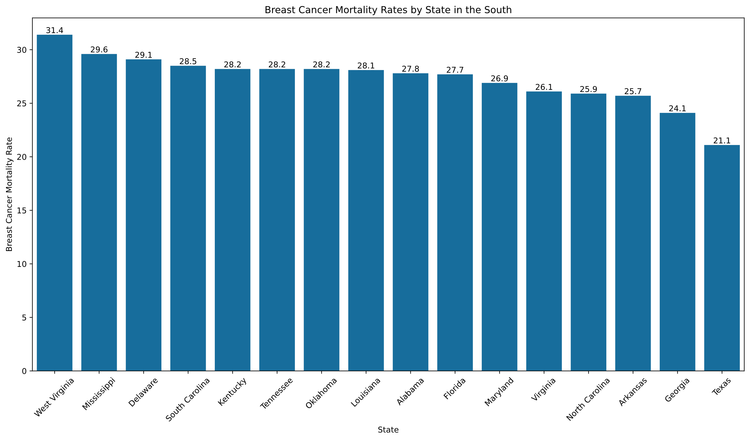
West Virgina has the highest breast cancer mortality rate in the country

Slide 10
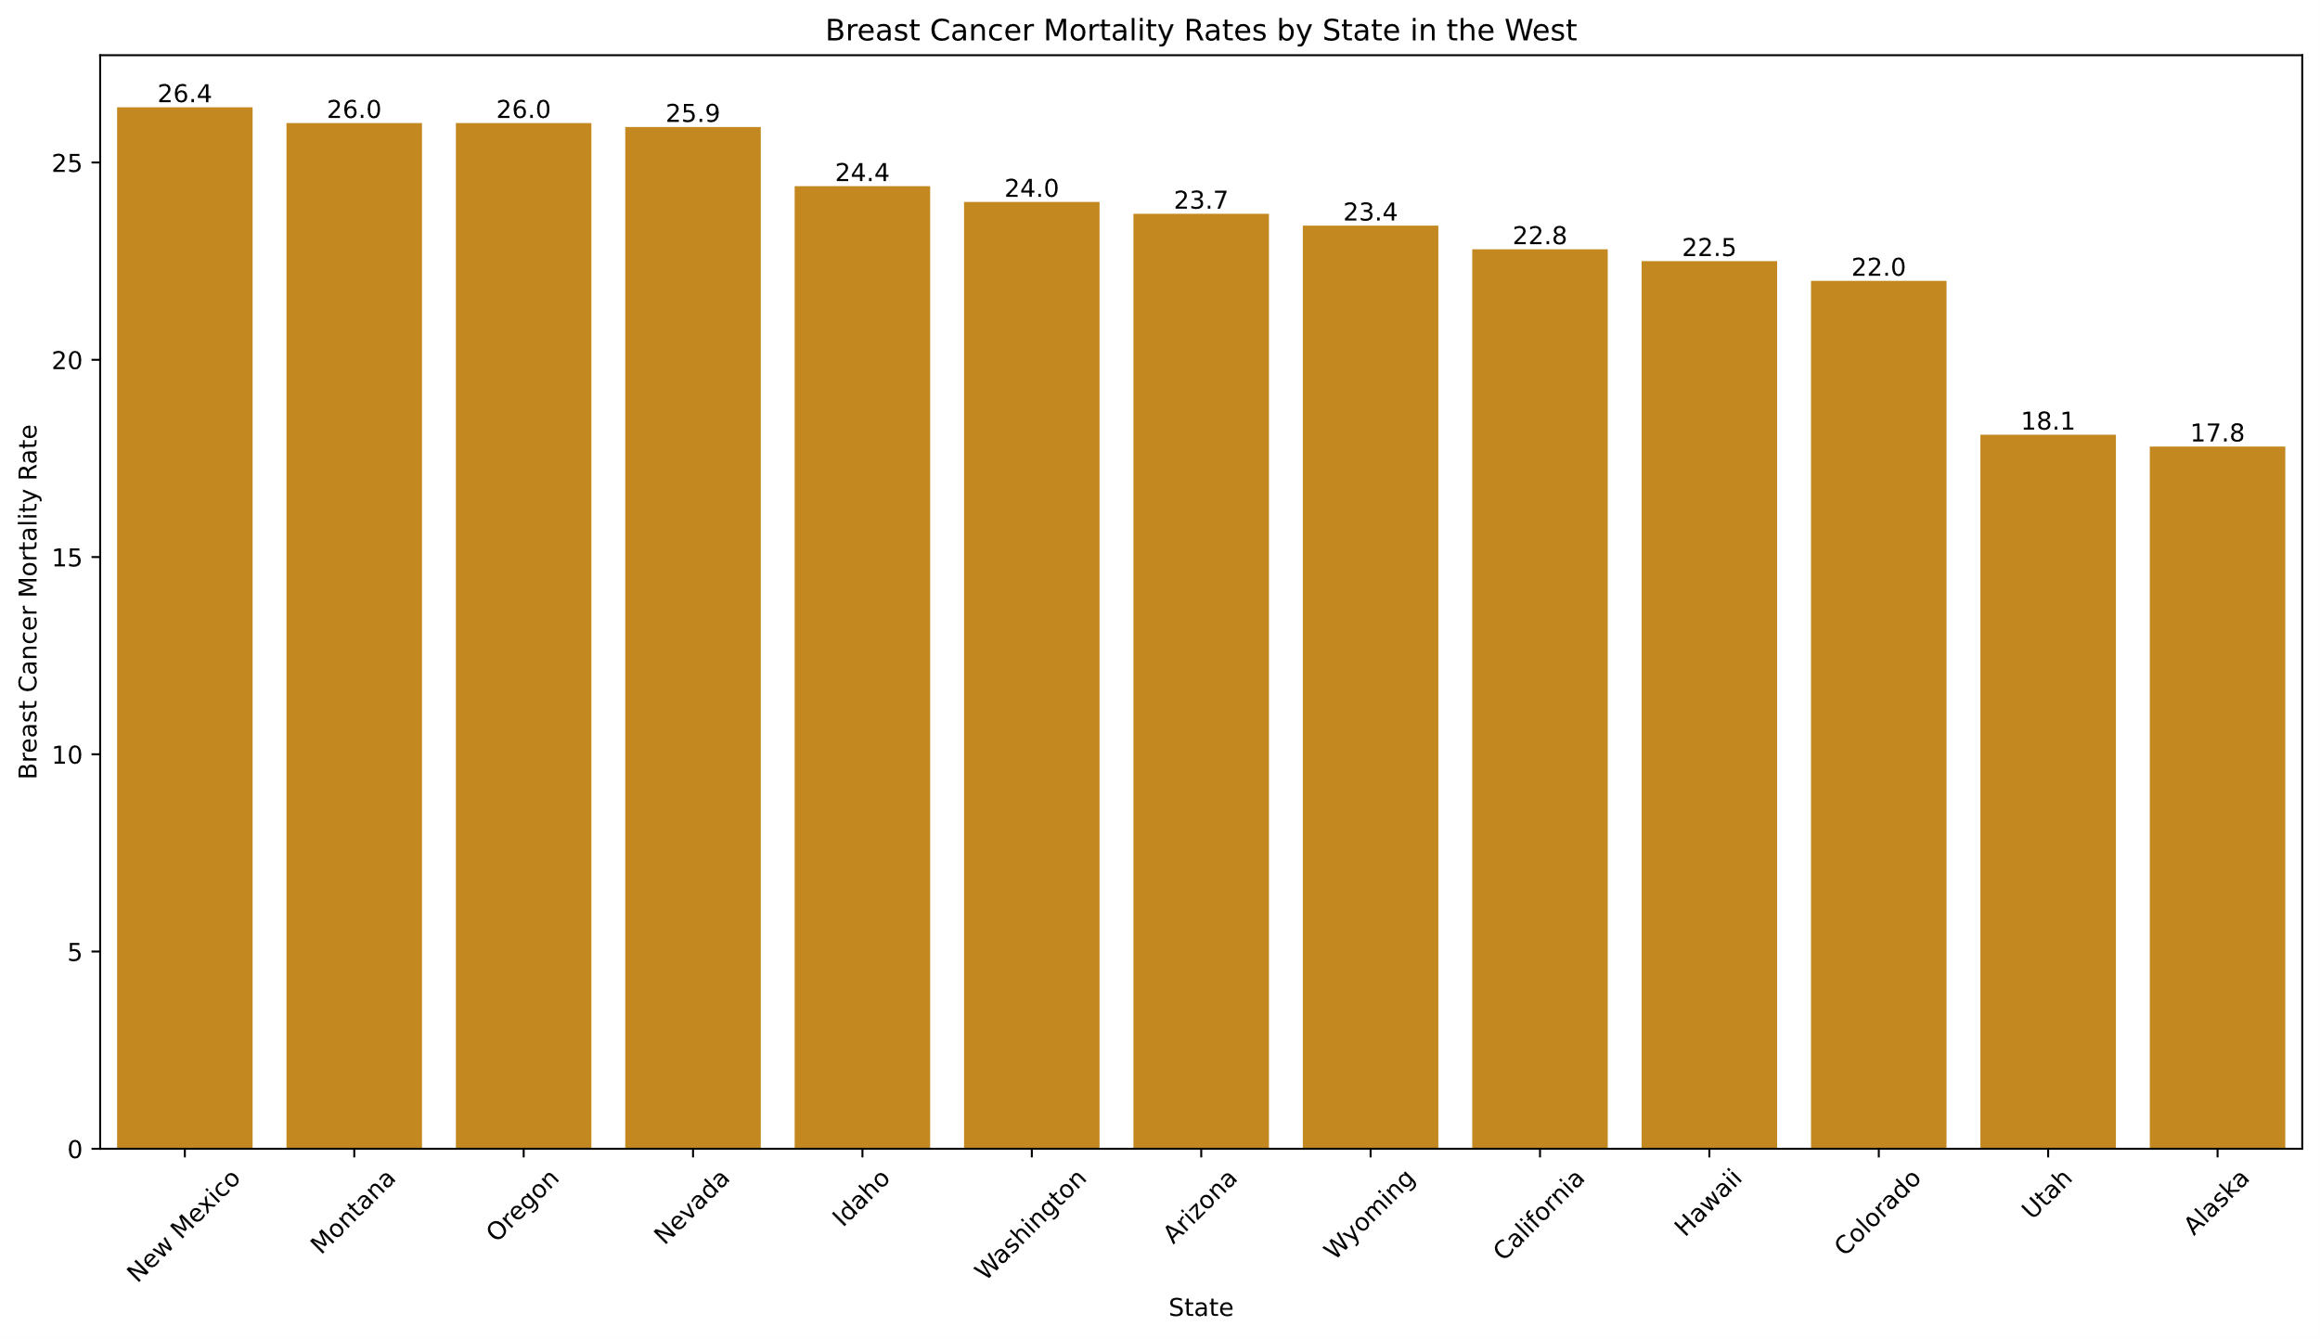
The west has the states with the two lowest breast cancer mortality rates

Slide 11
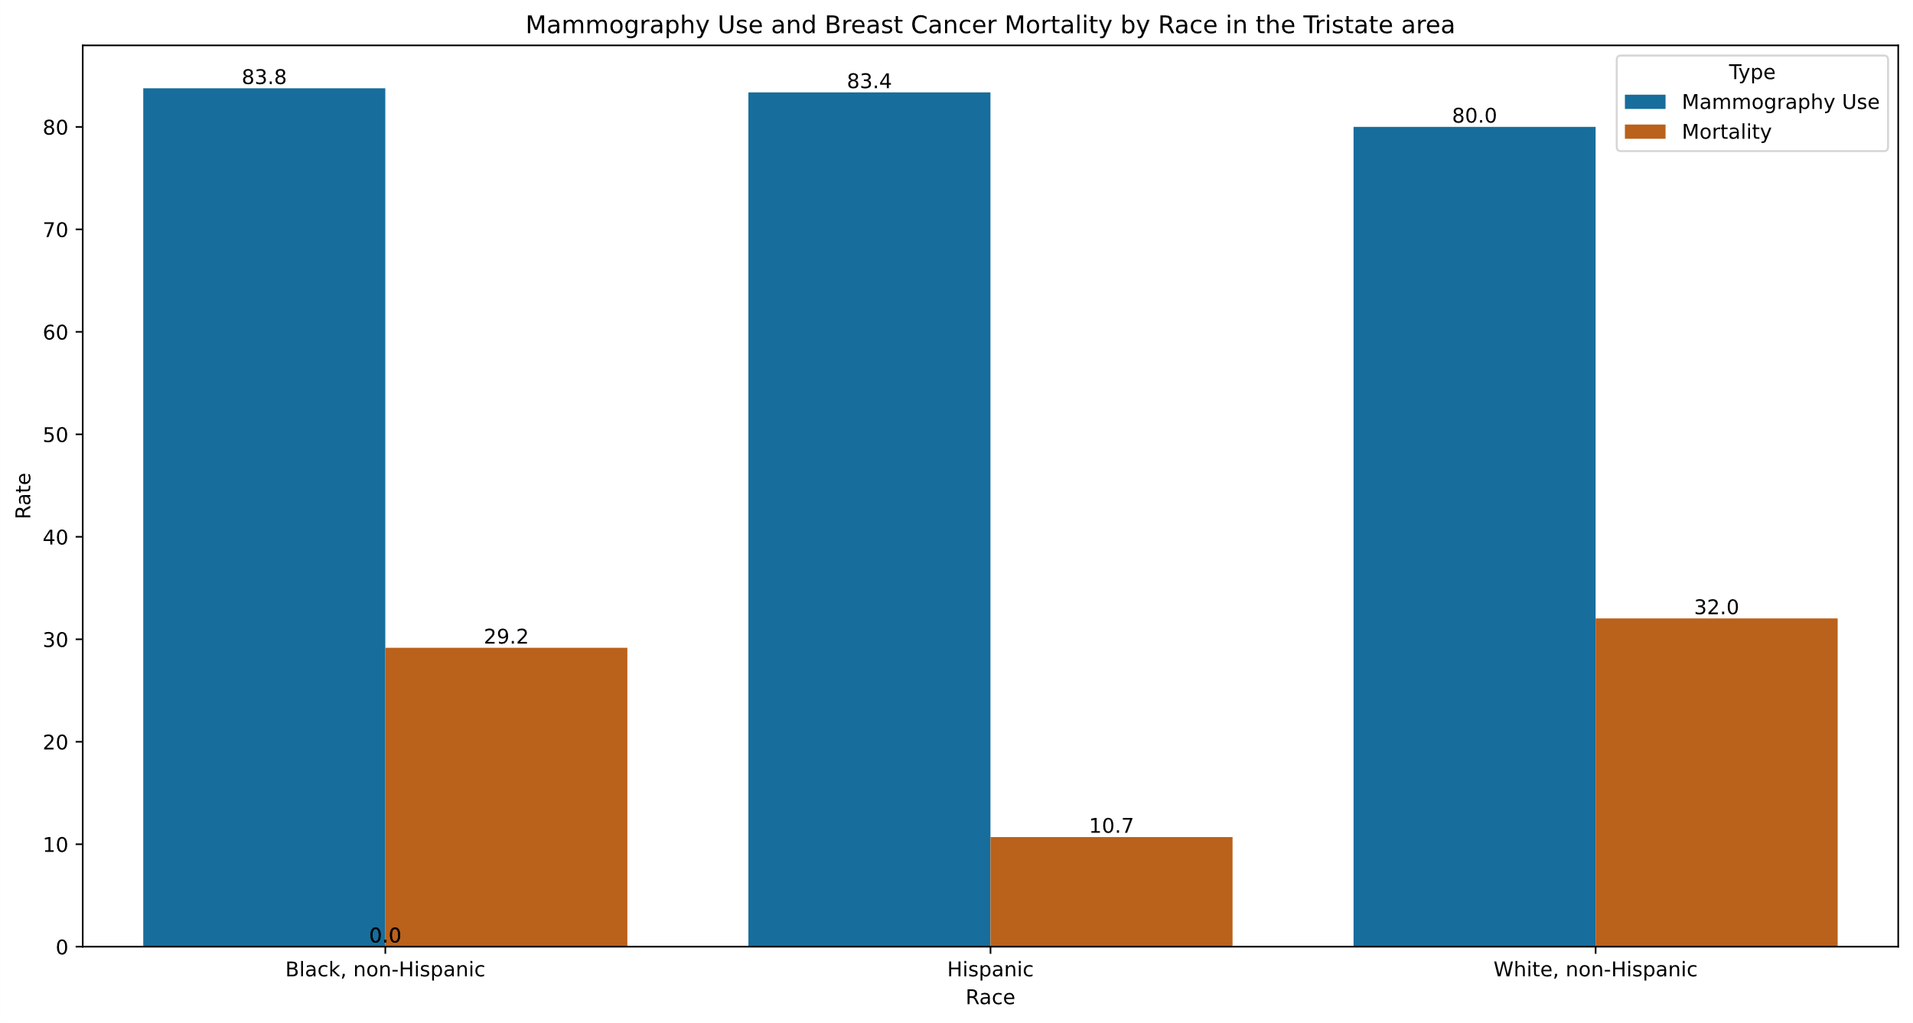
Hispanic women in the Tristate have the lowest breast cancer mortality rates

Slide 12
Recommendations
Preventative measures like self-exams should be encouraged between mammogram appointments
Additional Research to determine if the Hispanic women outside of the Tristate area experience lower breast cancer mortality rates.

Slide 13
Future Work
Further research on:
Breast cancer mortality rates by race outside of the Tristate area
Mortality rates by race for other types of cancers

Slide 14
Appendix

Slide 15
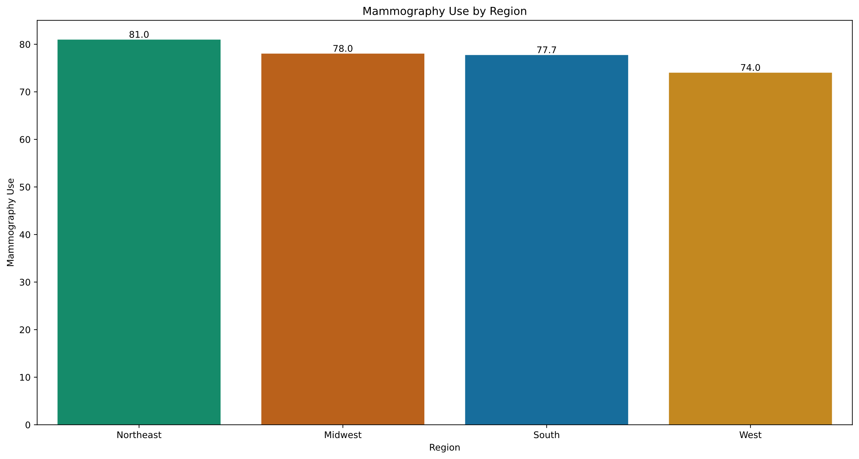

Slide 16
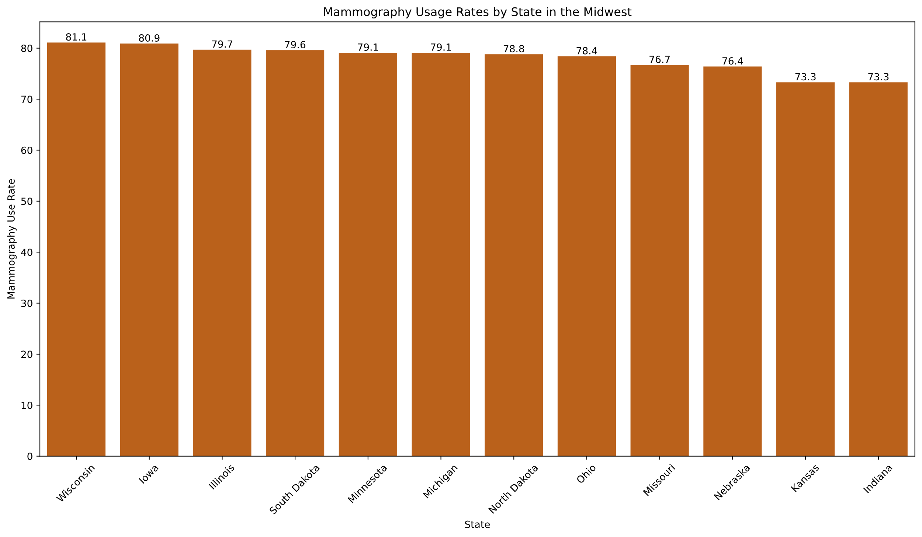

Slide 17
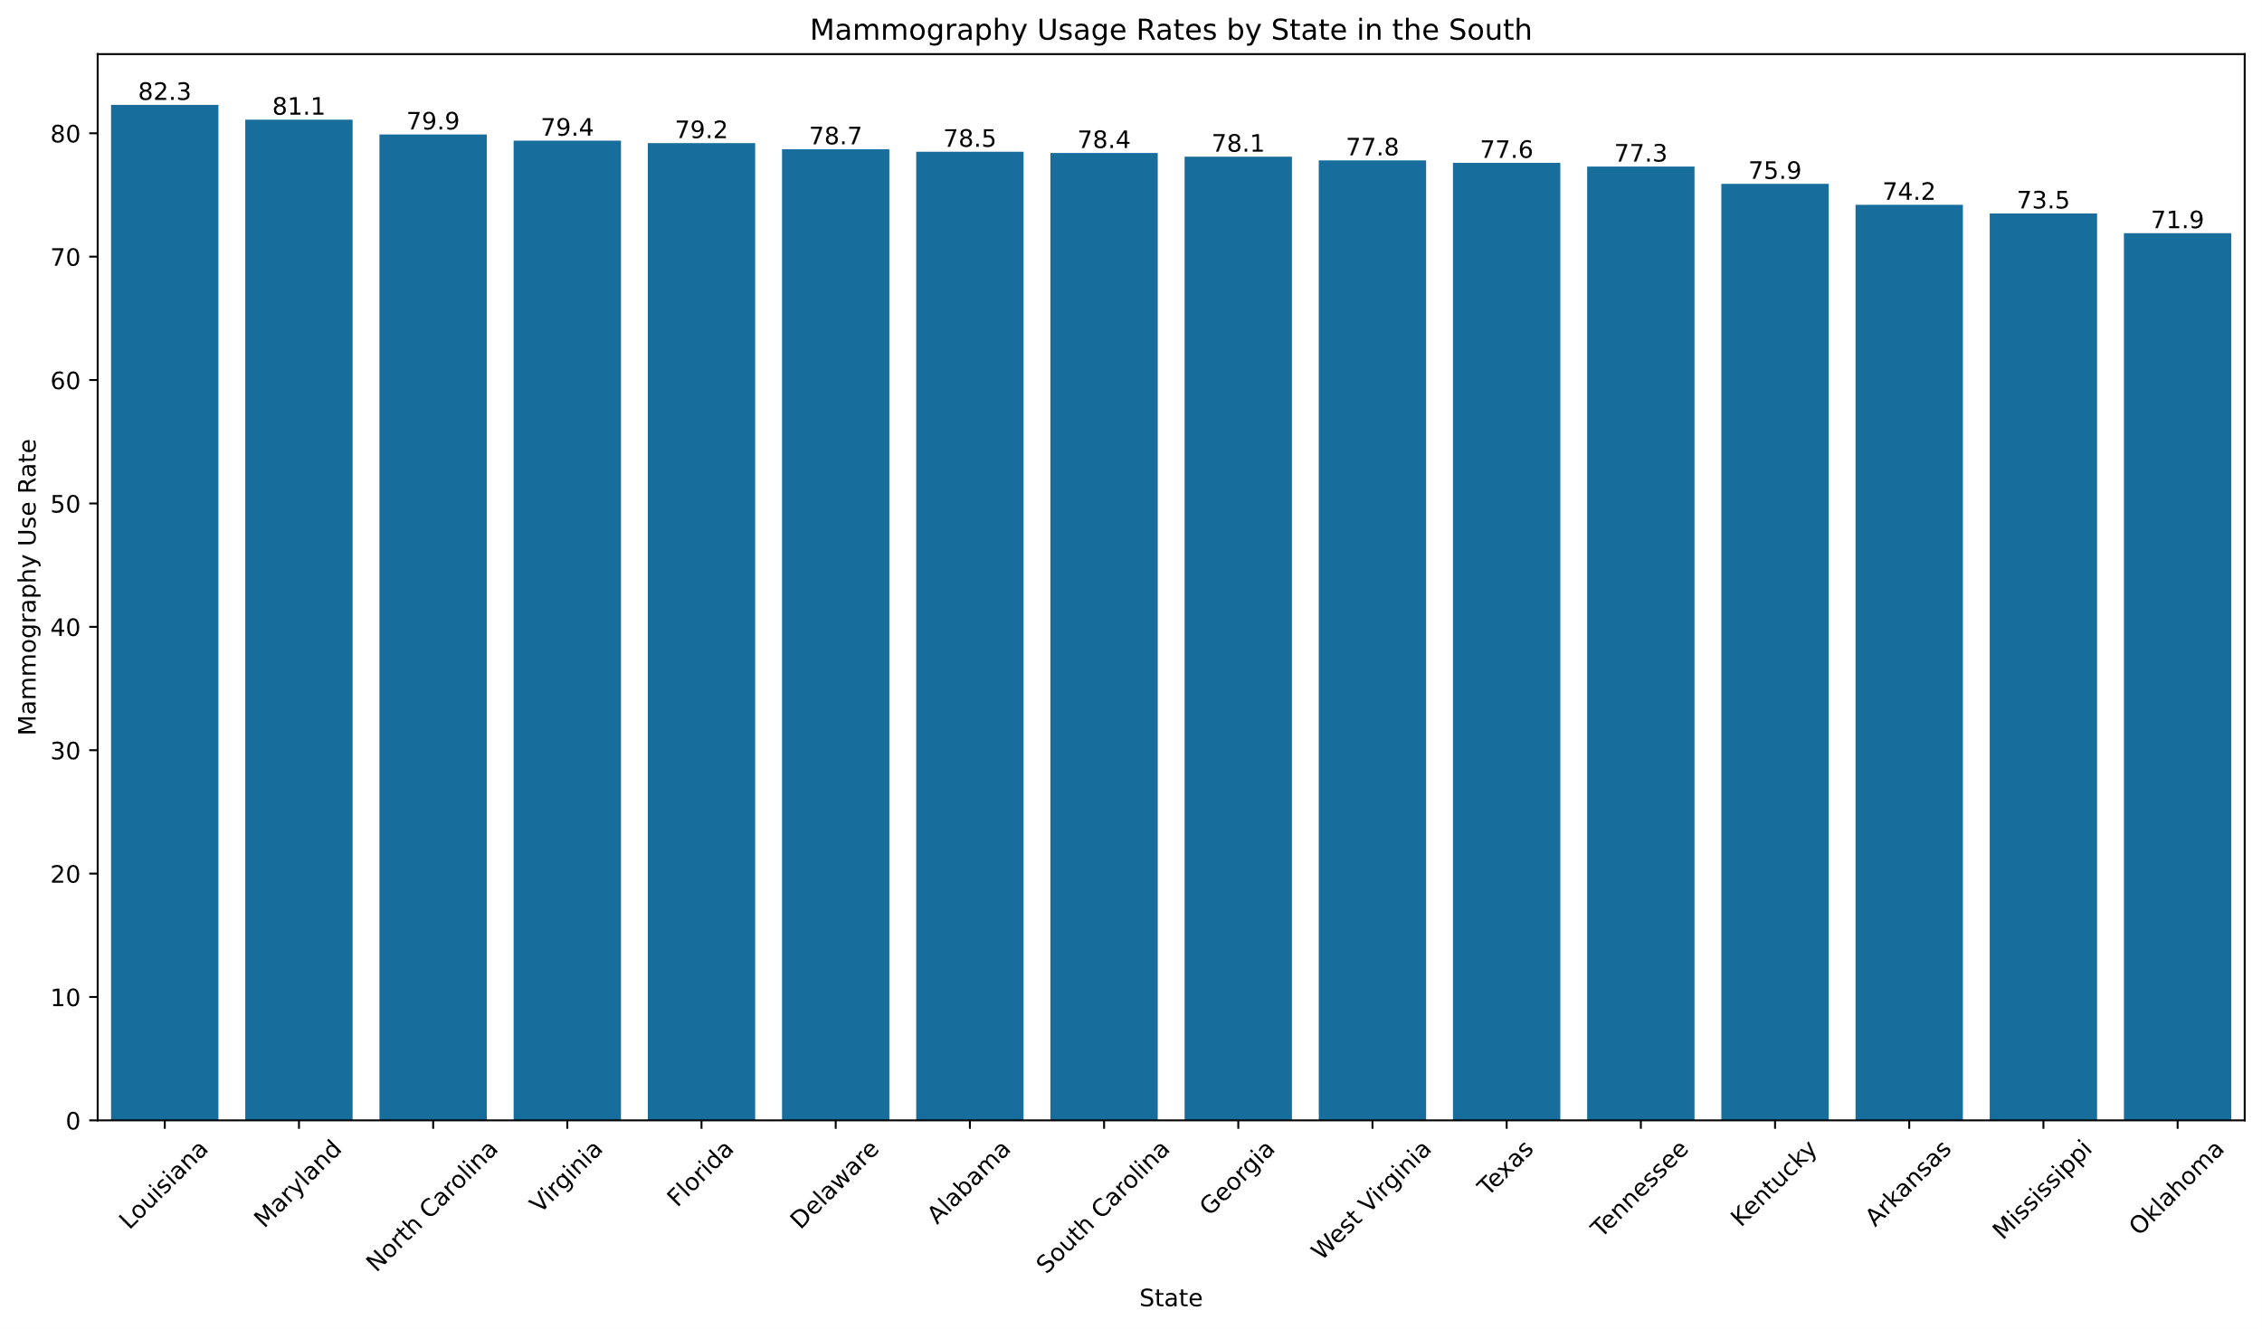

Slide 18
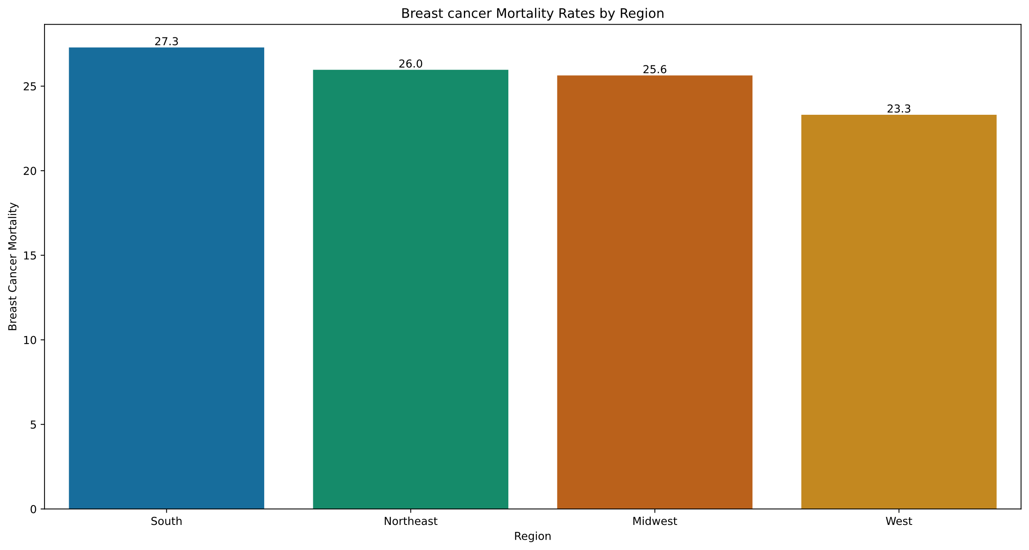

Slide 19
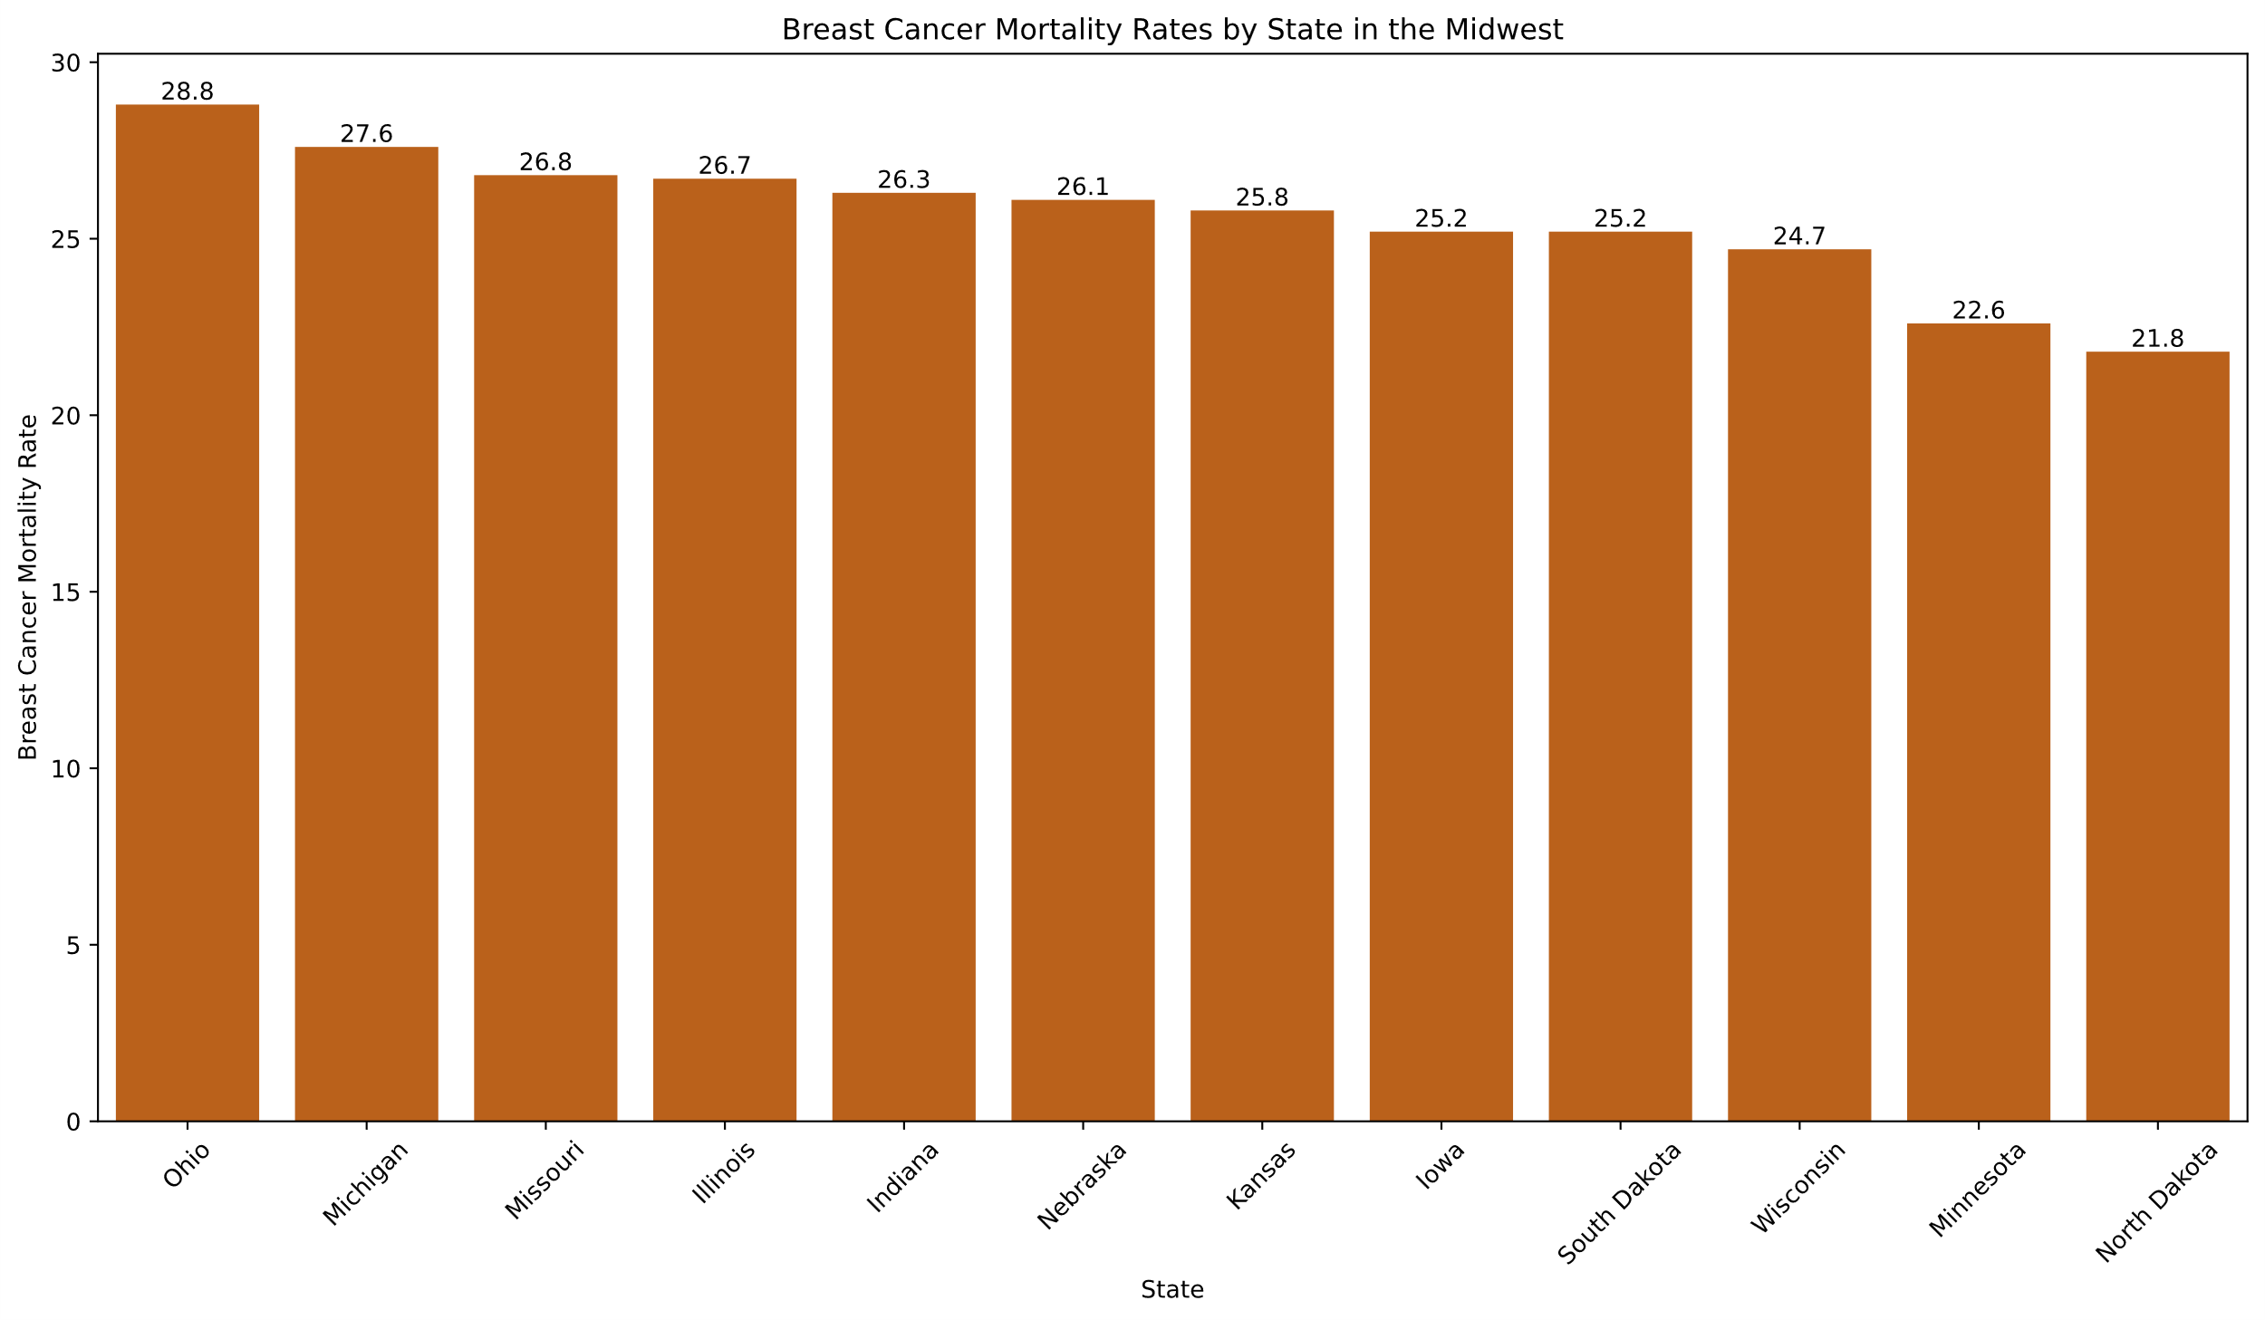

Slide 20
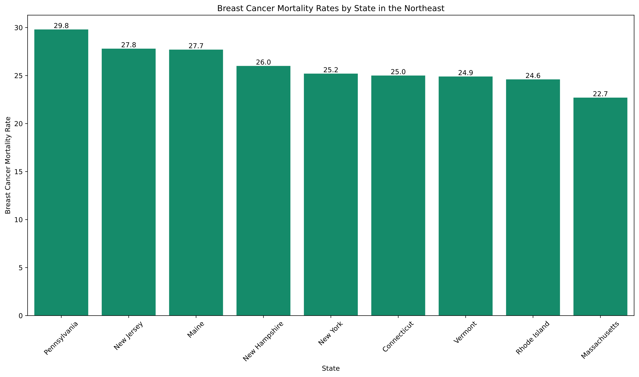

Slide 21
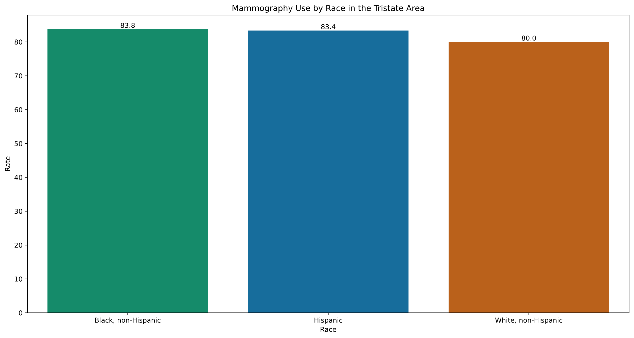

Slide 22
